Slide 1
What EXACTLY ARE Lists?
Lists can be thought of as resizable arrays
You can append/push and remove/pop/del items to lists
Lists can include
strings and integers
other objects and nested lists
Similar to ArrayList in Java
A list is an
ordered, mutable collection of objects
You can
Mix, match, add and remove any type of object in a list

Slide 2
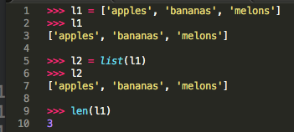
What EXACTLY ARE Lists?
Example:

Slide 3
Advanced List functions
Function | Description
cmp(list1, list2) | Compares elements of both lists.
len(list) | Get total length of a list
max(list) | Return item with max value
min(list) | Return item with lowest value
list(seq) | Convert a tuple into a list

Slide 4
More on nested lists
A nested list includes other list(s) as elements:
mylist = [[1,2,3],[4,5]] (two lists within a list)
You can go as deep as your lists need

Slide 5
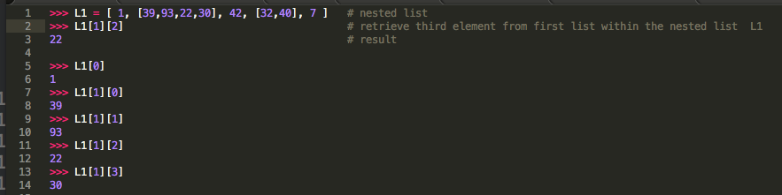
More on nested lists (Examples)
How to retrieve items from nested lists?

Slide 6
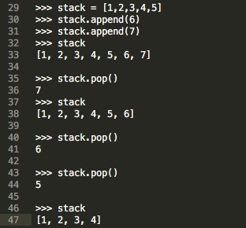
Lists as Stacks
The numerous methods of lists make it possible to use also lists as stacks. The last appended element will be retrieved first. This is the so called “last-in, first-out” concept.
append() adds an element to the top of a stack
pop() retrieves an element from the top of a stack
Example:

Slide 7
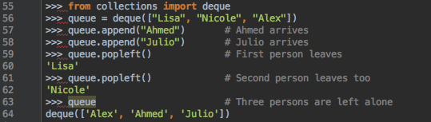
Lists as Queues
You can manipulate lists as queues so that an element will be inserted to the first place of a list (first in, first out queue policy).
A new element of a queue will be inserted with insert(). From the performance perspective insert() on lists will be slower than append() so that it is more common to use collections.deque as an alternative.
Example:

Slide 8
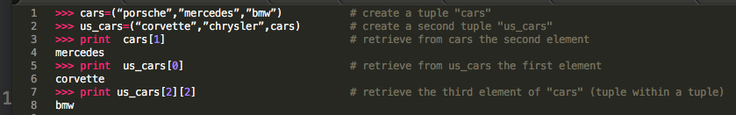
Tuples and sequences
Tuples are like lists but they are immutable
You can’t modify the elements of a tuple
The elements are separated by comma and enclosed in parentheses
Example:

Slide 9
Tuples and sequences
Lists,tuples and strings are sequences
There are two types of operations to fetch/retrieve specific items of a sequence
Indexing
A[start]
It allows to fetch a specific item in the sequence
Slicing
A[start:end:step]
Retrieve “a slice” or portion of the sequence
Tuples are
Comparable
Hashable
You can use tuples in dictionaries

Slide 10
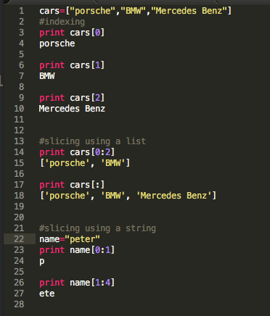
Tuples and sequences
Examples:

Slide 11
Sets
Set() is an unordered collection of unique elements
Sets allow mathematical operations like
unions, intersections, differences and symmetric differences

Slide 12
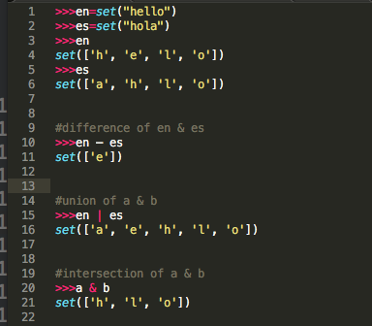
Sets
Examples:

Slide 13
Dictionaries
The main difference between dictionaries, lists and tuples is that dictionaries are indexed by keys. Though lists and tuples are indexed by a range of numbers.
An item of a dictionary consists of a key and a value
You can add, delete and search items
Keys are immutable
Keys are mapped to a value
Example: dic1 ={key1 : value1, key2 : value2}

Slide 14
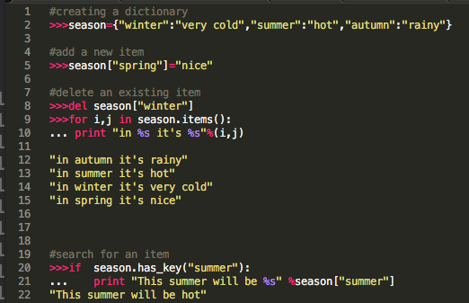
Dictionaries
Examples:

Slide 15
Special functions, looping techniques, conditions and comparisons
Function | Description
abs() | Absolute value
long() | Output as long
complex(r, i) | Complex number, (r)Real part, (i)Imaginary part
divmod(q,r) | Get quotient and remainder
int() | Output integer
c.conjugate() | Generate conjugate of a complex number
float() | Output as float
min(x) or max(x) | Smallest or greatest element in x

Slide 16
Special functions, looping techniques, conditions and comparisons
Looping technique | Example | Description
reversed(seq) | for i in reversed(xrange(1,10,2)): ... print i | loop over a sequence in reverse
enumerate(sequence, start=0) | for i in reversed(xrange(1,10,2)): ... print i | Retrieving position index and corresponding value
zip([iterable, ...]) | for q, a in zip(questions, answers): .... print-statement | Pair the results of a loop over at least two sequences
iteritems() | for k, v in knights.iteritems(): ... print k, v | Retrieving the key and corresponding value at the same time
Source: https://docs.python.org/2/tutorial/datastructures.html

Slide 17
Special functions, looping techniques, conditions and comparisons
Comparison of sequences and other types
(1, 2, 3) < (1, 2, 4)
[1, 2, 3] < [1, 2, 4]
'ABC' < 'C' < 'Pascal' < 'Python'
(1, 2, 3, 4) < (1, 2, 4)
(1, 2) < (1, 2, -1)
(1, 2, 3) == (1.0, 2.0, 3.0)
(1, 2, ('aa', 'ab')) < (1, 2, ('abc', 'a'), 4)
“Lexicographical ordering”
You can compare objects of different types

